Slide 1
Account and security Administration
Lecture 4
CoSc2043 – Network and System Administration

Slide 2
Section Overview
Users and groups
System Accounts
Account Management
System Administration Access

Slide 3
Purposes of accounts
Audit
Access Control
Authentication

Slide 4
Identity and Authentication
Why usernames?
  Grant access to system
  Control access to resources
  Accountability
Passwords
  Prove you are who you say you are
  Often weakest link in system security

Slide 5
User Accounts
UserID
User’s Full Name
Password
Home Directory
Groups
System Interface?

Slide 6
Username Selection
Must be unique
Max of 8 characters
Should be in all lower-case
Easy to remember
Set format
  Combination of first & last name
  No nicknames

Slide 7
Components of an Account
Username
Password
UID
GID
Stored in /etc/passwd
GECOS
Home Directory
Default Shell
sorr:lYi8.KpsFAb9M:126:10:Scott Orr:/home/sorr:/bin/csh
Notes:
General Electric Comprehensive Operating Supervisor (GECOS)
Typically used to store Additional information field such as the full name of the user or comment

Slide 8
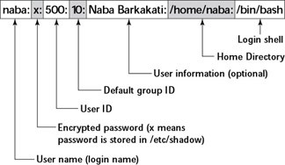
Components of an Acc. . .

Slide 9
Microsoft Security Identifiers
Created for every user, group, and machine
Never reused
S-1-5-21-D1-D2-D3-RID
  S-1-5-21: Standard prefix for NT
  D1-D2-D3: Local or domain identifier
  RID (Relative ID): Unique part of SID

Slide 10
Weak Passwords
No passwords used
Smoking Joes
Information about user
Dictionary Attacks
  Modification of user ID or name
  Modification of dictionary(s) word(s)
  Keyboard patterns
  Any systematic, algorithmic generator
Notes:
Smoking Joes
Surprisingly, experts believe that a significant percentage of all computers without password content controls contain at least one account where the username and the password are the same. Such accounts are often called "Joes." Joe accounts are easy for crackers to find and trivial to penetrate. Most computer crackers can find an entry point into almost any system simply by checking every account to see whether it is a Joe account. This is one reason why it is dangerous for your computer to make a list of all of the valid usernames available to the outside world

Slide 11
Selecting Strong Passwords
At least 14 characters in length
Mix of case, numbers and special characters
Something you can remember
Techniques
  License plating (becoming weaker)
  Acronyms from phrases
  Passphrases

Slide 12
Pass Phrase Examples
  smo11012006
    Poor
  ardl79BEf76357
    14 spaces
    Hard to remember
    Good
  MydogSkiplovestoplayfetcheveryday
    33 spaces
    Easier to remember
    Better
  Myd0gSkipluvs2playfetchev3ryday
    31 spaces
    Easier to remember
    Limit Duplicate letters –substitute with numbers, punctuation, or special characters
    Best

Slide 13
UNIX Password Storage
Uses a One-Way Hash Encryption
  Based on DES
  Uses a 2 character “salt”
  MD5/SHA1 – More secure replacement
‘*’ Used to lock accounts
Readability Issue

Slide 14

UNIX Password Encryption
Password
balloons
Salt
Vs
DES
One-way
Hash
0x00000000
Randomize
25 times
VsjqYhTwQiJPw
Asciify
Newer systems use MD5/SHA1 now
Valid: A-Za-z0-9./
Notes:
Data Encryption Standard (DES) of the National Institute of Standards and Technology (NIST). In normal operation, DES uses a 56-bit key (8 7-bit ASCII characters, for instance) to encrypt blocks of original text, or cleartext , that are 64 bits in length.

Slide 15
/etc/shadow
Password field in /etc/passwd replaced with ‘x’
Readable only by superuser
Contents
  Username
  Password
  Password aging information

Slide 16
Lan Manager Password Encryption
Password
14charpassword
14CHARP
P
ASSWORD
P
DES
One-way
Hash
DES
One-way
Hash
0xAAD3B435B51404EE
0xE79E56A8E5C6F8FE
0xAAD3B435B51404EE

Slide 17
Windows Password Encryption
16-bit character
Unicode
MD4
One-way Hash
Password
SAM
6-14 character passwords
Stored in registry and files
Backwards compatible with LAN Manager (2nd entry)

Slide 18
Special Users
Guest
System Accounts
Superuser / Administrator
  Full Access to all system resources
  Superuser Equivalency
“Principle of Least Privilege”
Notes:
The principle of least privilege (PoLP) refers to an information security concept in which a user is given the minimum levels of access – or permissions – needed to perform his/her job functions.

Slide 19
Linux System Accounts
root
  System Administration account
  UID of 0
bin – Owner of standard system programs
daemon – Owner of (most) system daemons
mail – Owner of mail system
nobody – Unprivileged system account

Slide 20
Linux Groups
Stored in /etc/group
  Group Name
  Password (rarely used)
  Group ID Number (GID)
  List of members
newgrp – Change default group
sysadmin:*:14:root,sorr

Slide 21
Common Windows Groups
Administrators
Backup Operators
Power Users
Network Configuration Operators
Remote Desktop Users
Users
Role Based Model

Slide 22
Linux User Account Creation
Add entry to /etc/passwd
Create initial password (/etc/shadow)
Add entry to /etc/group (optional)
Create home directory & copy startup files into it
Create mail file (optional)
Test!!!

Slide 23
Linux Account Creation Tools
Manual Creation
  vipw / vigr
  passwd user
  Default scripts found in /etc/skel
useradd
GUI Tools
  Linux Web-based tools (e.g. Webmin)
  Windows: Computer->Manage->Local Users and groups

Slide 24
Linux Account Modification Tools
passwd – Change password
chfn – Change GECOS entry
chsh – Change default shell
  (Listed in /etc/shells)
usermod & GUI tools
Disabling accounts
  Locking password (‘*’ as first character)
  Change shell to /bin/nologin

Slide 25
Removing a Linux Account
Kill any processes owned by user
Remove all files owned by user
Remove account entries (Linux)
  /etc/passwd
  /etc/shadow
  /etc/group
userdel & GUI tools

Slide 26
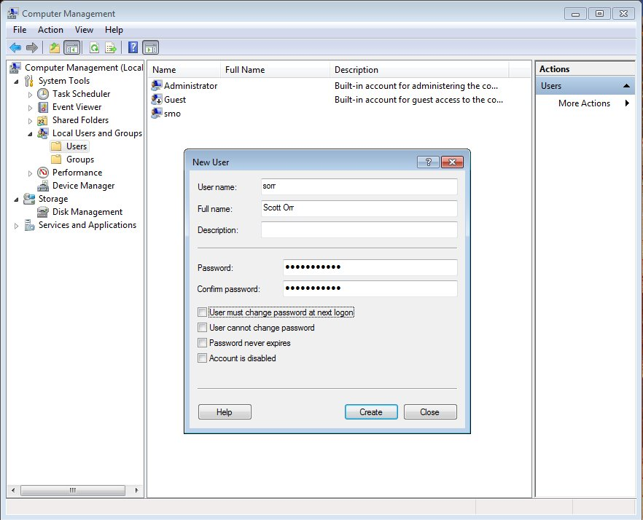
Adding a Windows Account

Slide 27
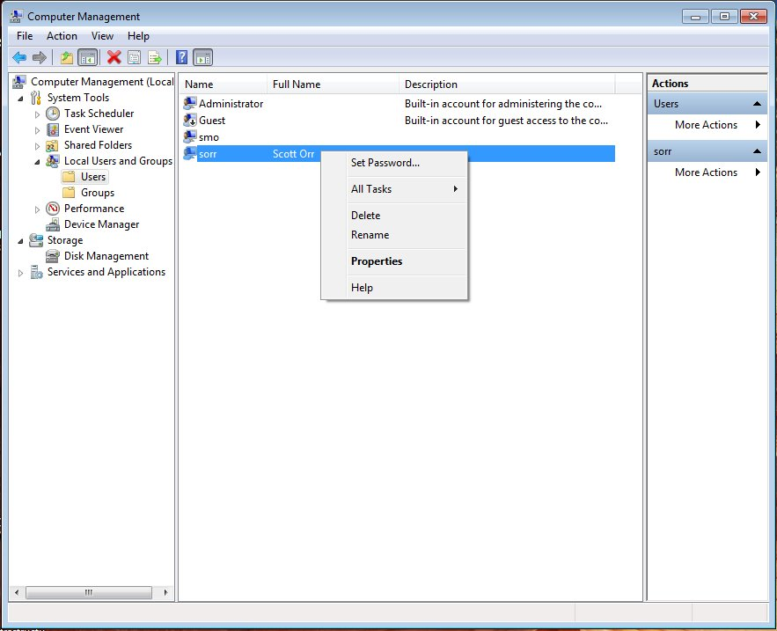
Modify a Windows Account

Slide 28
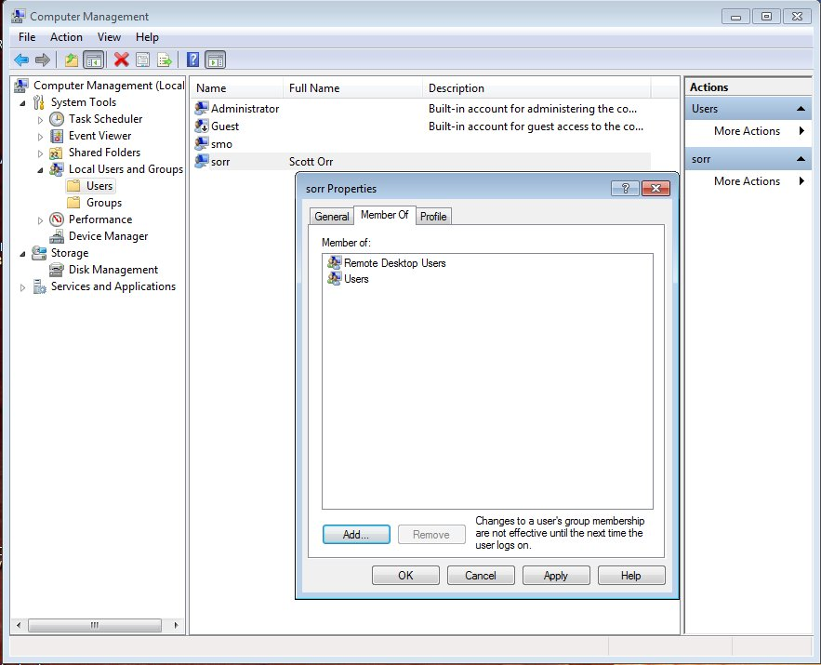
Windows Group Membership

Slide 29
Windows User Mgmt CLI
List local users
  net user
Create a new user
  net user <username> <password> /add
Delete a user
  net user <username> /del

Slide 30
Windows Group Mgmt CLI
List groups
  net localgroup
List group membership
  net localgroup <groupname>
Add/Remove group members
  net localgroup <groupname>
    <username …> </add | /del>

